Slide 1
CSCI 4110 Graphics Hardware Part One
Mark Green
Faculty of Science
UOIT

Slide 2
Introduction
In the first course we were just interested in getting something to work, now we want it to work efficiently
This starts with the hardware we are using
The next slide is a high level picture of the hardware components we are interested in
We will discuss each of them in detail

Slide 3
Architecture
Memory
CPU
Graphics
Card
Display

Slide 4
Memory
CPUs directly work on data in registers, the memory system provides this data
Registers work at the same speed as the CPU, no delay in accessing them
The next level is the L1 cache, also works at CPU speed, small delay in accessing
The next level is the L2 cache, this cache feeds the L1 cache, it is about an order of magnitude slower, but much larger
Some systems have L3 caches, larger but slower
Finally we have DRAM, very large and very slow

Slide 5
Cache
L1 cache is typically 16 Kbytes, one for data and one for instructions
L2 cache is typically 256 Kbytes, and L3 cache can be multiple Mbytes
Organized as cache lines, 64 or 128 bytes of contiguous memory, transfer a cache line at a time
Most data types are multiple bytes, so will be accessed together, want all of the value in the same cache line
Cache is fast, but takes up a lot of space on a chip, can be as much as 50%

Slide 6
DRAM
Most memory is DRAM, large and cheap, but not very fast
Design is optimized for capacity and not speed
A DRAM cell stores 1 bit, about the smallest thing we can design in VLSI, one transistor and one capacitor
Can store a bit for 30 to 100 msec, must be refreshed regularly
Chip organized as a 2D array of cells, retrieve a row at a time, stored in a fast row buffer on the chip
Adjacent bits can be retrieved quickly

Slide 7
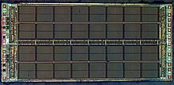
DRAM

Slide 8
DRAM
Reading a cell destroys its value, contents of the row buffer must be written back to the memory array
DRAM designed to feed cache, not to access individual locations
First read takes a long time, subsequent reads in the same row are much faster, could be 10x faster
Don’t want to jump all over DRAM, this is very slow

Slide 9
Memory
Lesson:
Avoid referencing DRAM
When you do, reference contiguous locations
Align data to cache lines
Example:
for(i=0; i<N; i++)
for(j=0; j<M; j++)
a[i][j] = b[i][j]*c[i][j]
This makes good use of memory, changing the subscript order will be much worse
When in doubt trying changing the order

Slide 10
Memory
A double value is 8 bytes, if this crosses a cache line two lines will need to be retrieved from DRAM, twice as long
Make data structures as compact as possible, group items of the same type together
Most compilers will try to do this for you, but you should give them as much help as possible

Slide 11
CPU
CPUs have changed radically over the past 5 years
For many years we could double CPU speed every three years, improvements in VLSI
Smaller features produced faster chips, but 4 GHz is about the upper limit:
Features quite small -> quantum effects, easy to destroy features
Excessive heat generation, can’t cool chip
But we still have chip area, could increase cache sizes, but there is a limit to this

Slide 12
CPU
Solution is to have multiple cores, slower processors, but collectively more computational power
Some issues with cache design, but we don’t need to worry about this
Problem is developing programs that use multiple CPUs
Sequential programs are hard to write, parallel ones are much harder
In general this is a difficult problem, but many algorithms parallelize quite easily

Slide 13
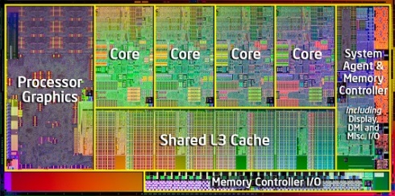
CPU – Intel i7

Slide 14
CPU
Ray tracing is the best example
The illumination for each primary ray can be computed independently, the rays don’t interact
Can assign a ray to each core and compute them in parallel
If we have 4 cores this should be 4 times faster, in practice we get very close to this
Other algorithms can also be sped up, but how do we write code that does this?

Slide 15
CPU
There are numerous tools for parallel programming, we could use low level APIs like threads
This gives us the greatest amount of control and performance, but development is hard
For many applications this doesn’t pay off
A much higher level solution is OpenMP, a rather old standard (>15 years), recently very popular due to multi-core processors
This is a compiler extension, use #pragma statement to suggest parallelism
Very easy to learn package

Slide 16
CPU
Our previous array example could be parallelized in the following way:
#pragma omp parallel for private(i,j)
for(i=0; i<N; i++)
for(j=0; j<M; j++)
a[i][j] = b[i][j]*c[i][j]
The compiler will parallelize the for loop right after the #pragma
Compiler switches can turn OpenMP on and off simplifying debugging

Slide 17
Graphics Card
High level architecture of a graphics card is shown on the next slide
The heart is the GPU, but the other components are also important
Bus interface: PCIe in many cases, everything must go over this bus, geometry, programs and textures
Want to store as much as possible on graphics card, this is controlled by the driver
Try not to thrash between graphics card and main memory, reduce texture sizes

Slide 18
Graphics Card
DRAM
Bus
Interface
GPU
Video

Slide 19
Bus Interface
Solution: remove the bus interface, put the GPU on the same chip as the CPU
GPU and CPU share same memory, increased bandwidth
AMD was first to do this with their APU chips
Intel now has consumer chips that do this as well
Mobile: NVidia Tegra line of mobile chips, see the next slide

Slide 20
NVidia Tegra K1

Slide 21
DRAM
Most of the chip space on a GPU is devoted to processors, so we need external memory
On lower end cards this is standard DRAM chips, usually DDR3
Higher end cards currently use GDDR5, which is similar to DDR3
GDDR uses the same memory cells as DDR3, but it has a different bus interface
Memory on a graphics card doesn’t co-exist with other devices, so there are fewer constraints on their interface

Slide 22
DRAM
There are two things that we can do with this:
A much wider data bus, which increases the overall bandwidth of the memory system
Higher clock speeds and better clock management
GPUs tend to transfer large chunks of contiguous memory locations, GDDR takes advantage of this
It has deeper row buffers, since the GPU is likely to request adjacent rows of memory

Slide 23
Video
In order to display we need a video signal
Convert the frame buffer into a video signal
In early graphics systems the video circuits and the GPU both accessed the same memory, had to share the bandwidth
An early solution was VRAM, two data ports:
Standard memory port for the GPU
Shift register based data port for the video circuits
Both ports acted independently

Slide 24
Video
The video circuits access a row of pixels at a time, so the shift register interface made sense
Now use double buffering and similar techniques, ping pong chips between GPU and video
With multiple displays can access different areas of memory at the same time
There have been quite a few video standards, many are now obsolete
VGA: the last analogue standard and still going strong, analogue signals for red, green, blue, horizontal sync and vertical sync

Slide 25
Video
VGA is very flexible, so still widely used, can carry higher resolution signals than some of the digital standards
DVI: complicated standard that supports both analogue and digital video signals, on separate pins
All connectors have same basic shape, but can have different pins and different capabilities, can cause confusion
HDMI: use of a more standard connector with fewer pins than DVI, there is some compatibility between the standards

Slide 26
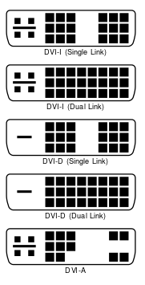
DVI Connectors
Dual Link is used for
increased bandwidth and
not dual monitors. Used for
higher resolution monitors

Slide 27
Video
HDMI can carry a wider range of signals, including Ethernet
Supports better two way communications than DVI, has the notion of commands
Display Port: designed to be a replacement for HDMI, but this really hasn’t occurred
Vision: graphics cards and monitor would have display port, use a display port cable between them
This has not happened on the monitor side, common interfaces are VGA, DVI and HDMI

Slide 28
Video
Display port used on video cards and laptops since it takes less space
Can easily get 4 display port connections on a graphics card, but fitting 2 DVI ports can be difficult
This is the main advantage of display port, converters to other standards

Slide 29
GPU
This is the meat, where all the action is
“Wheel of Reincarnation”, formulated early in the history of graphics:
Graphics architectures tend to repeat themselves over time. A period of evolution, over a decade or so, gets us back to where we started.
We have gone from special purpose fixed function graphics devices to fully programmable devices that rival CPUs, and then back again to fixed function …
Special purpose hardware gives us more performance for lower price

Slide 30
GPU
Trade-off between flexibility and performance in computer architecture
If we understand a computation well enough we can build special purpose hardware for it
Brief history of graphics hardware starting around 1981, the start of large scale use of VLSI
James Clark developed a special chip for graphics, called the geometry engine
Observed that there is a lot of floating point computation: matrix, vectors and lighting
Geometry engine performed computations in hardware

Slide 31
SGI
Clark formed a company, Silicon Graphics to make high end graphics workstations with these chips
Around $60,000, but the competition was over $250,000, became very successful
Put the standard graphics pipeline in silicon, first company to do this
This is the same company that gave us OpenGL
As the hardware evolved they made heavy use of microprogramming
Their chips were programmable, but not by users

Slide 32
NVidia
SGI missed the PC revolution, did not see the need to move to low cost systems, moved opposite way
In mid 1990s the key hardware architects left SGI for a new startup called NVidia
Initial products duplicated graphics pipeline at much lower cost
Problem: wanted to use more than one texture at a time, started with just two
But, how do we combine the textures, there are many possibilities, too many for a few state variables

Slide 33
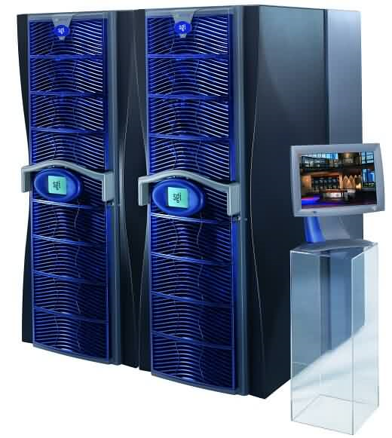
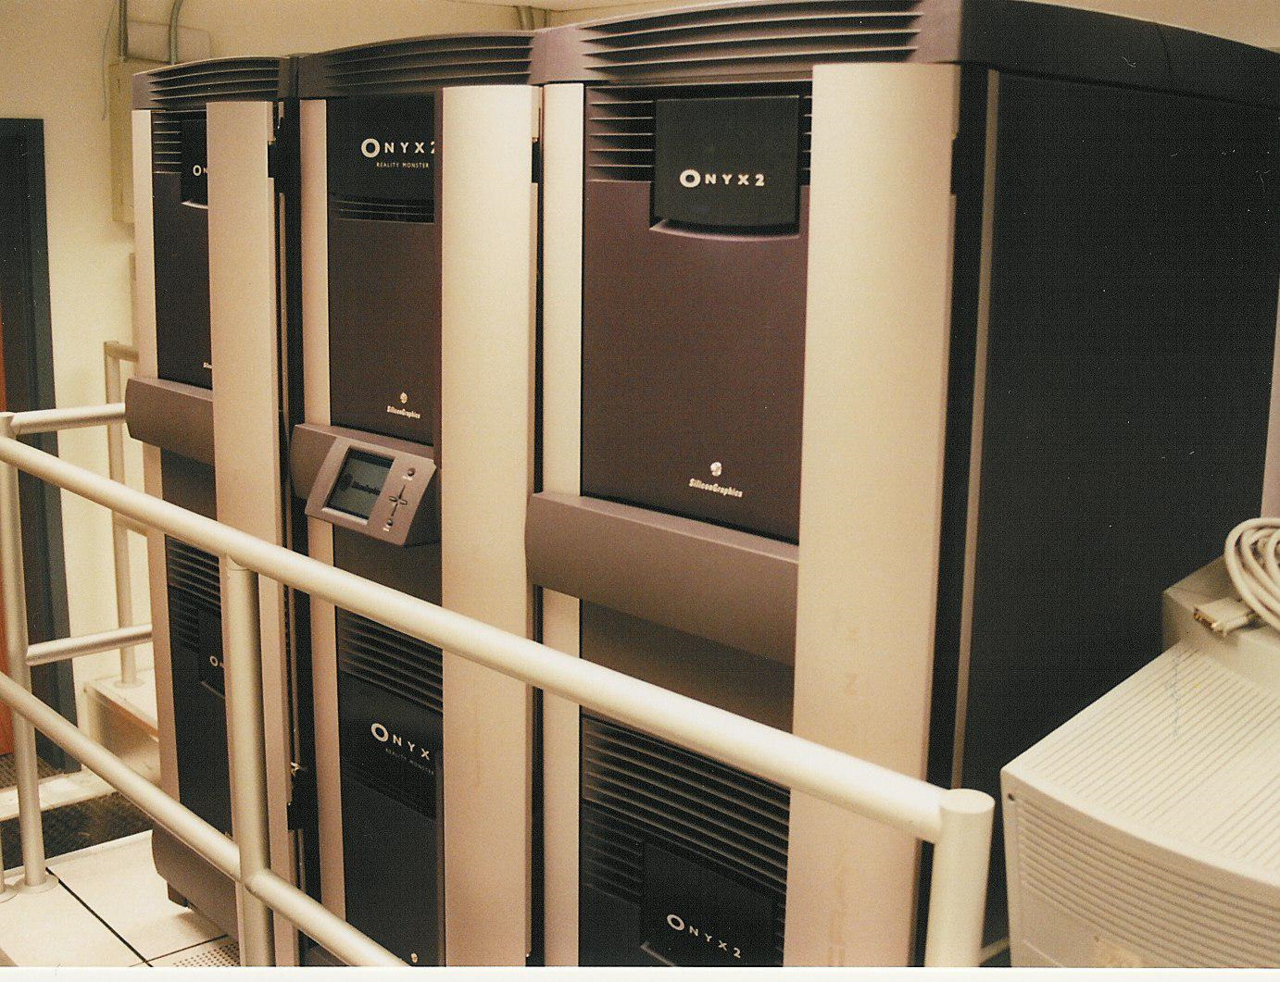
SGI Onyx

Slide 34
NVidia
Introduced simple programming at the fragment level, texture combiners
A small handful of instruction types, programs could be about 6 instructions long
This was assembly level programming
Started a competition with several other companies, mainly ATI (now part of AMD)
Started adding more instructions and longer programs
Could do standard lighting calculations at the fragment level

Slide 35
GPU
There were no branching statements, straight line code
Each instruction was applied to multiple fragments in parallel to achieve high performance
Applied the same idea to floating point computations, a programmable vertex processor
The two processors had very different instruction sets, still programmed in assembler and no branching
Not very easy to program
Early 2000s architecture shown on the next slide

Slide 36
GPU- Early 2000s
Bus
Interface
Vertex
Processor
Interpolation
Fragment
Processor

Slide 37
GPU
Eventually branching instructions were added, instruction sets became more complicated, longer programs (a whole 128 instructions!)
The two instruction sets started to converge
High level languages started to appear
NVidia produced Cg, the first popular language for GPU programming
This was followed by GLSL, the shading language that is part of the OpenGL standard
Things started to look good

Slide 38
GPU
But, there is a problem here
We have dedicated vertex and fragment processors, this can be a performance bottle neck
If we have a lot of fragment processing, the vertex processors are idle, the reverse also holds
There is no way to design the hardware that satisfies all applications
Solution: one set of processors, can dynamically allocate them to where they are needed, all processors can handle all programs

Slide 39
GPU
The data cycles through the GPU
It starts with the vertex programs, the output is pumped back through the chip as input to the fragment programs
We can now add other types of shaders, they all use the same silicon: geometry, tessellation, computation
We could see more in the future
This is the current state of the art in modern desktop architectures

Slide 40
GPU
The following slide shows the architecture of the NVidia Pascal GP100(recent high end GPU)
The bulk of this chip are the computational cores, 3840 of them
How do we get this many cores on a chip, a CPU chip has at most 10?
GPU cores are quite different, they are a SIMD architecture (Single Instruction Multiple Data)
There is one instruction decode unit for a group of 32 cores, all the cores perform the same instruction in lock step

Slide 41
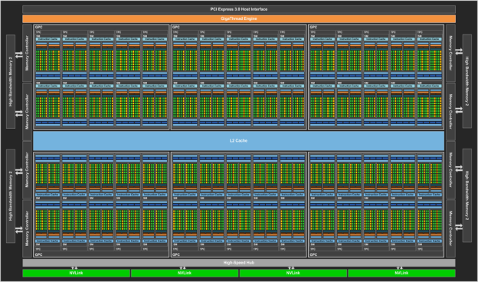
Pascal GP100 Architecture

Slide 42
SIMD
Instruction decode on a CPU is very complicated, larger than the instruction execution part
In a GPU this is simplified considerably, so instruction decode takes up much less room
The emphasis is on the computational units
The next slide show the GP100 SIMD unit, which is called a streaming multiprocessor, or SM
The instruction decode is at the top of the chip, a relatively small area
Most of the chip area is devoted to the computational elements

Slide 43
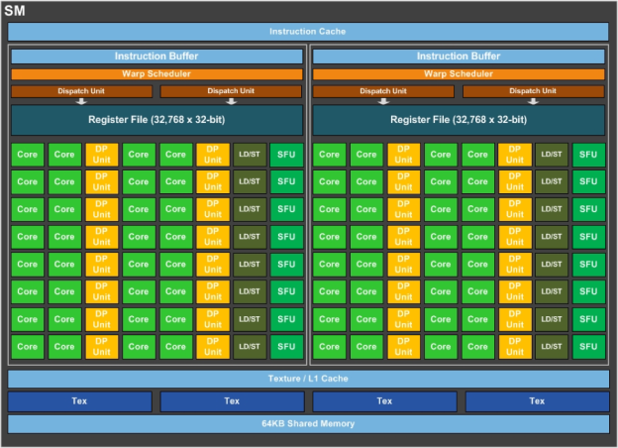
SIMD Processor

Slide 44
SIMD
The SM units in the GP100 have fewer cores than previous architectures, at least half the number
But they have the same amount of memory, this gives each core more memory
This translates into more local memory for our shader programs
The GP100 organizes the SMs into 6 Graphics Processing Clusters, or GPCs, this is a new level of organization for NVidia chips

Slide 45
SIMD
The SIMD architecture has implications for how we program a GPU
Many cores are executing the same instruction in parallel, this is okay for straight line code, but causes problems for control structures
Example: if-then-else, each core will evaluate the condition, for some it will be true and for others it will be false
Each of the cores is marked as true or false and then we execute both parts of the if statement

Slide 46
SIMD
Start by executing the statements in the then part, only the cores marked true will execute these instructions
Then execute the instructions in the else part, only the cores marked false will execute these instructions
In general, half the cores will be idle during the execution of an if statement
Long if statements can have a significant performance hit

Slide 47
SIMD
Similar problems occur in loops
Example: while loop, each core will evaluate the control expression, as long as one core has a true value the loop must be executed
This can result in a large number of idle cores
This is not a problem with for loops since there is a fixed number of iterations
Need to keep this in mind when writing GPU programs, can have a significant impact on performance

Slide 48
NVidia GP100
The GP100 introduces a new memory organization where the memory chips (actually the dies) are stack one on top of the other
The dies in a stack are linked together by up to 5000 wires running between them
Current system have 4 dies in each stack significantly increasing the memory bandwidth
Going from 288 GB/s on previous architectures to 732 GB/s on the GP100

Slide 49
Aside
We are now beginning to see intermediate languages (similar to assembler)for GPUs, on both AMD and NVidia CPUs
Motivated by computational use of GPUs, more on this later
Vulkan – by default GPUs programmed in assembler
Another turn of the wheel of reincarnation

Slide 50
One More Crank
Turing architecture was introduced last summer, a significant evolution
High level architecture of chip is on the next slide, looks somewhat similar to earlier GPUs
The RTX 2080Ti has 6 GPCs, the RTX 2080 has 4 GPCs and the other models have 3 GPCs
It is basically the same architecture it is just scaled for greater performance

Slide 51
Turing Architecture

Slide 52
Turing Architecture
A Turing SM is shown in the next slide, there are several differences with previous designs:
The floating point and integer units can work in parallel
The tensor cores are used for machine learning, they are tuned to large matrix operations
The RT core is used for ray tracing, it can do ray-triangle intersections and bounding volume hierarchies
A program on an SM can spawn other programs, like starting a new process

Slide 53
Turing SM

Slide 54
Turing Architecture
Putting different types of computations on the GPU, more specialized units
Also the ability to launch programs
Beginning to look like a CPU, not quite there yet
When will we have a GPU that has its own CPU?
This is the logical evolution and will turn everything upside-down, soon the GPU will need its own GPU

Slide 55
Tiled Architectures
This approach doesn’t work too well on mobile devices, where power is a concern
Tendency to write the same location many times, too much access to DRAM - expensive
Solution: divide the screen into a number of tiles, each tile is small enough to fit into on chip memory
Sort the triangles into tiles, called binning, each triangle has a bit vector, identifies the tiles it appears in
Process one tile at a time, run the complete pipeline on each triangle

Slide 56
Tiled Architectures
Once a tile is complete, the image is written to DRAM, thus only one expensive write instead of many
Downside: each triangle may be processed many times, but this is done on chip, so it is fast
In some cases triangles are sorted to optimize hidden surface
Note: z-buffer kept on chip, no need to write it to DRAM

Slide 57
Displays
This is where all the fun is, largely ignored by graphics researchers until about 8 years ago
Used to view monitors and projectors as black boxes, not very interesting, just used to display the results of our work
Now we know that there are cool things inside of these boxes
In particular Spatial Light Modulators (SLM)
A SLM dynamically changes (modulates) the optical properties (light) of individual pixels (spatial)

Slide 58
Displays
There are many types of SLMs, we will look at only a small number, then how they can be used
One of the most common is the LCD (liquid crystal)
The structure of the a typical LCD panel is shown on the next slide
LCDs work by changing the polarization of light, so we have polarizers on both sides of the panel
The polarizers are thin sheets that pass light of only one polarity

Slide 59
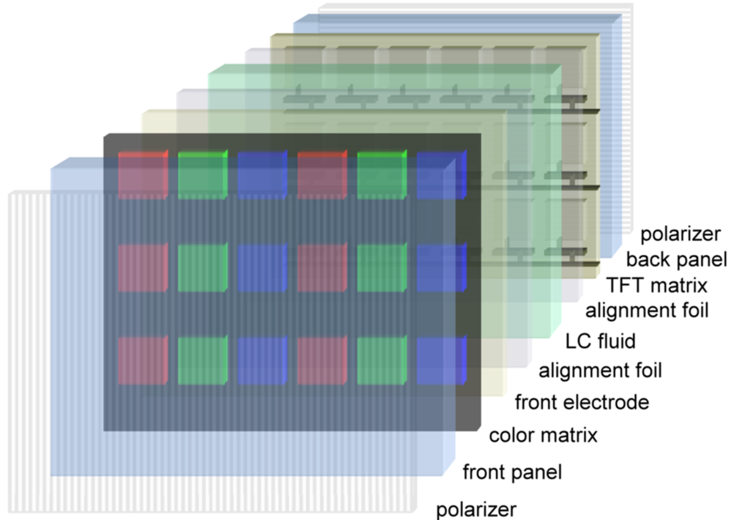
LCD

Slide 60
LCD
What’s polarity?
Light can be viewed as a wave (it can also be viewed as a particle), so think of a sine wave traveling through 3D space
The wave travels in a straight line, but the vibrations could be about any angle around this line
The next slide shows two possible vibration angles
In polarized light all the waves have the same angle
If we only have the blue wave in the following slide we have polarized light

Slide 61
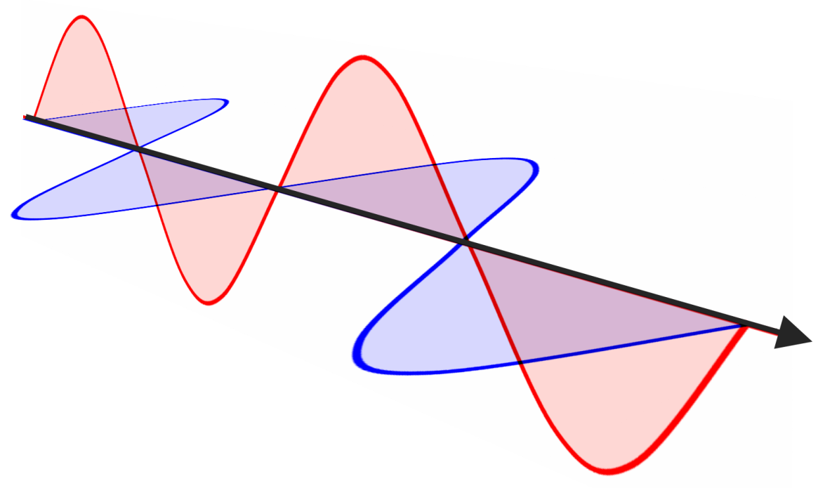
LCD

Slide 62
LCD
This is linear polarization, which is the simplest kind
A polarizer is used to select light with a particular polarization, see the next slide
We can also have optical elements that shift the polarization
Liquid crystals are long molecules that can be aligned by applying a voltage to them, when this occurs their optical properties change
They are arranged in small cells, with three cells for each colour pixel

Slide 63
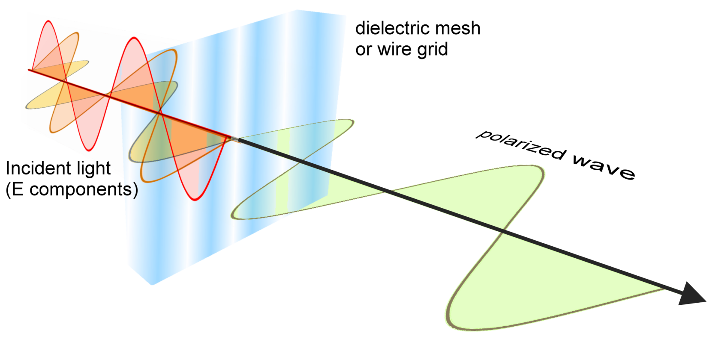
LCD

Slide 64
LCD
The behavior of an individual LCD cell is shown in the next slide
On the left a positive voltage is applied to the top layer and light is blocked
On the right light passes through the cell, but its polarization is changed
In this mode the LCD is basically transparent
In between we get various levels of transparency, which can be achieved in several ways

Slide 65
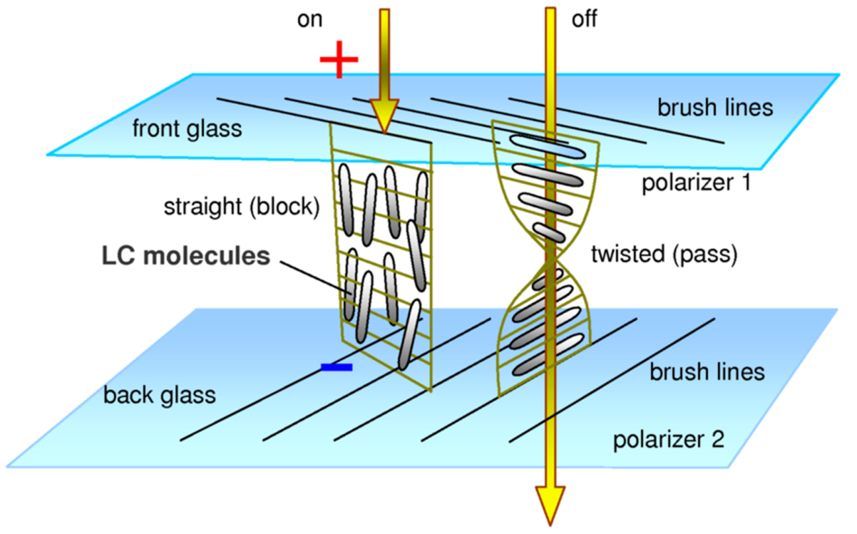
LCD

Slide 66
LCD
So far we can’t see anything
An LCD display has a backlight that provides the light required to see what is on the LCD
Originally the backlights where florescent, but they are now mainly LED
The light should be as even as possible to avoid intensity variations across the display
The fun starts when we use more than one LCD panel
Each panel can do 256 levels of red, green and blue

Slide 67
LCD
If we stack two panels their images are multiplied
This gives us 256*256 = 65,536 levels for each of red, green and blue
This is called a High Dynamic Range (HDR) display
The bottom panel becomes a pixel accurate variable backlight
An LCD is called a transmissive SLM, since it modifies the light that passes through it

Slide 68
Reflective Displays
LCDs change the light that is transmitted through them, we can also change the light that is reflected off an SLM
Look at two common technologies
LCoS (liquid crystal on silicon) is based on applying a coating of liquid crystal on top of a CMOS chip
A reflective surface is placed on top of the CMOS layer and below the liquid crystal
Charges applied to the liquid crystal are used to change its polarizing properties, and thus whether light is reflected

Slide 69
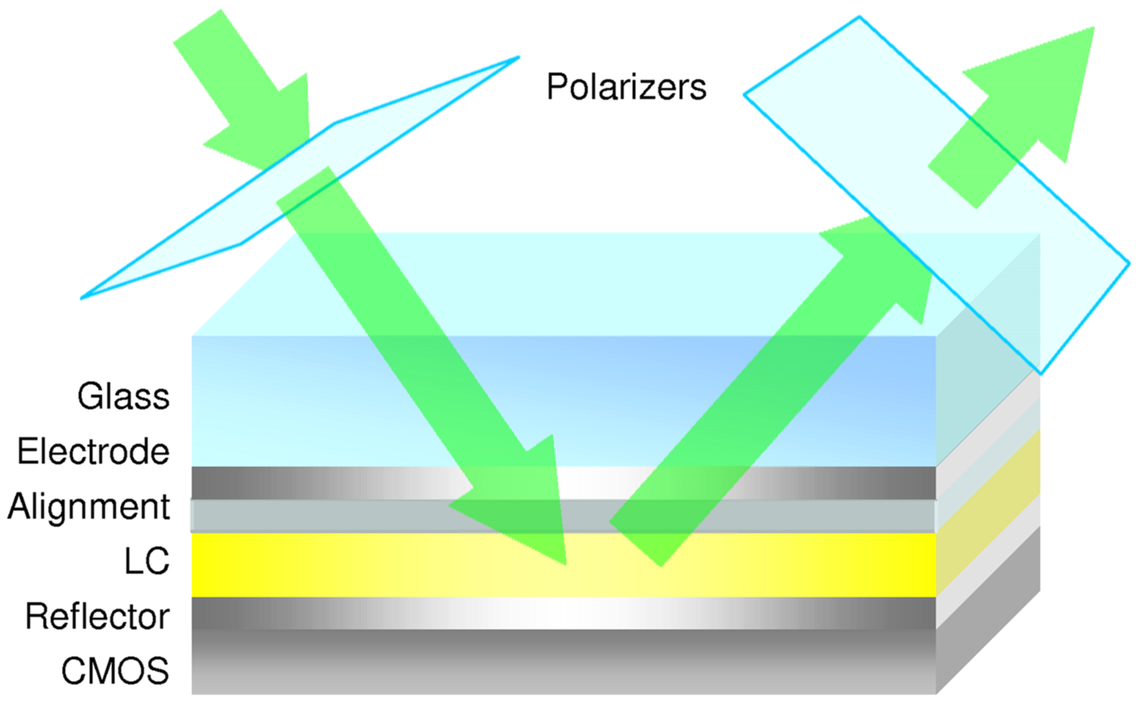
LCoS

Slide 70
LCoS
This removes the need for a backlight
It can also have smaller pixels, which can be used for higher resolution or smaller displays
F-LCoS (Ferroelectric LCoS) can produce pixels smaller than 8 μm, these displays are used in head-mounted displays
Can have full HD in a 1” display
LCoS is also used in projectors as shown on the next slide

Slide 71
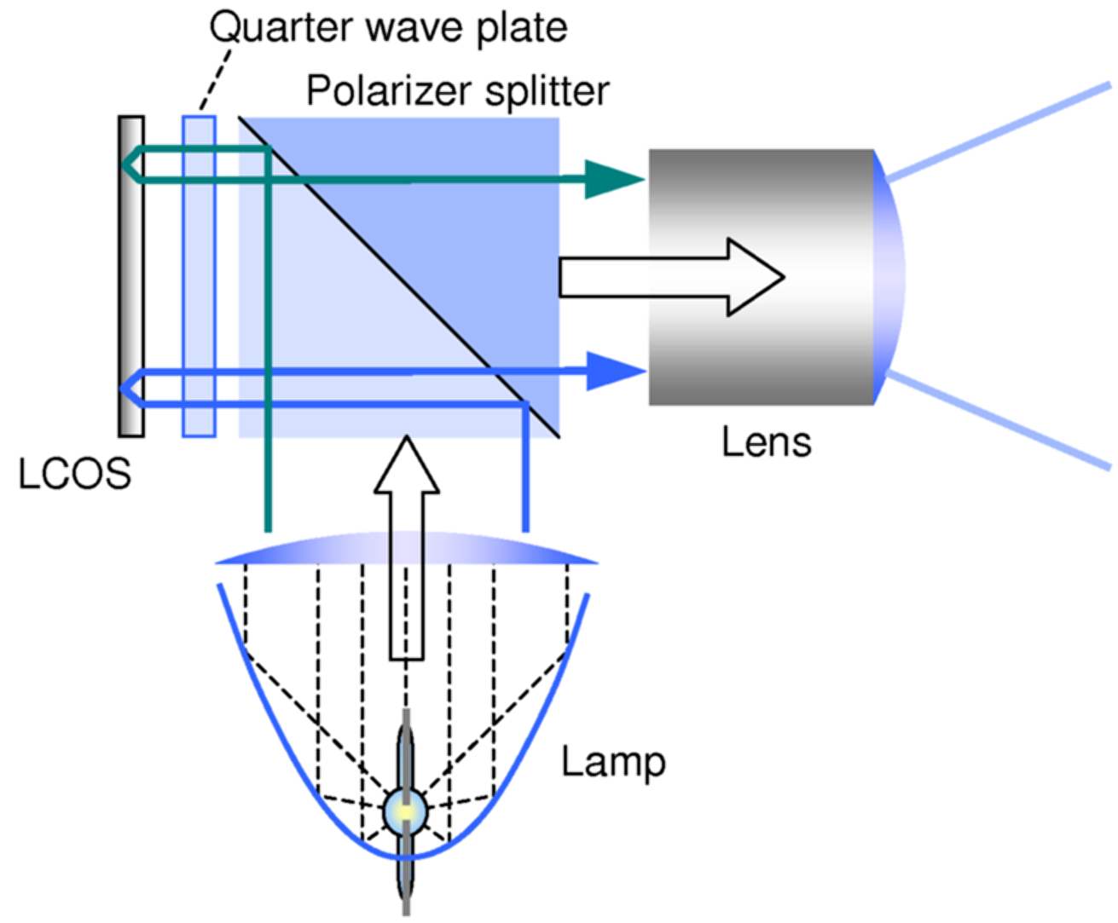
LCoS

Slide 72
DMD
Digital micromirror devices (DMD) are based on fabricating very small mirrors on a silicon chip
These mirrors can move using silicon hinges and springs, see the next slide
In one configuration the mirror reflects light towards the viewer and in the other the light is reflected away from the viewer, this gives basically a binary signal
We can get grey levels by controlling the amount of time the mirror points towards the viewer
If it is only half a pixel time we can get half intensity

Slide 73
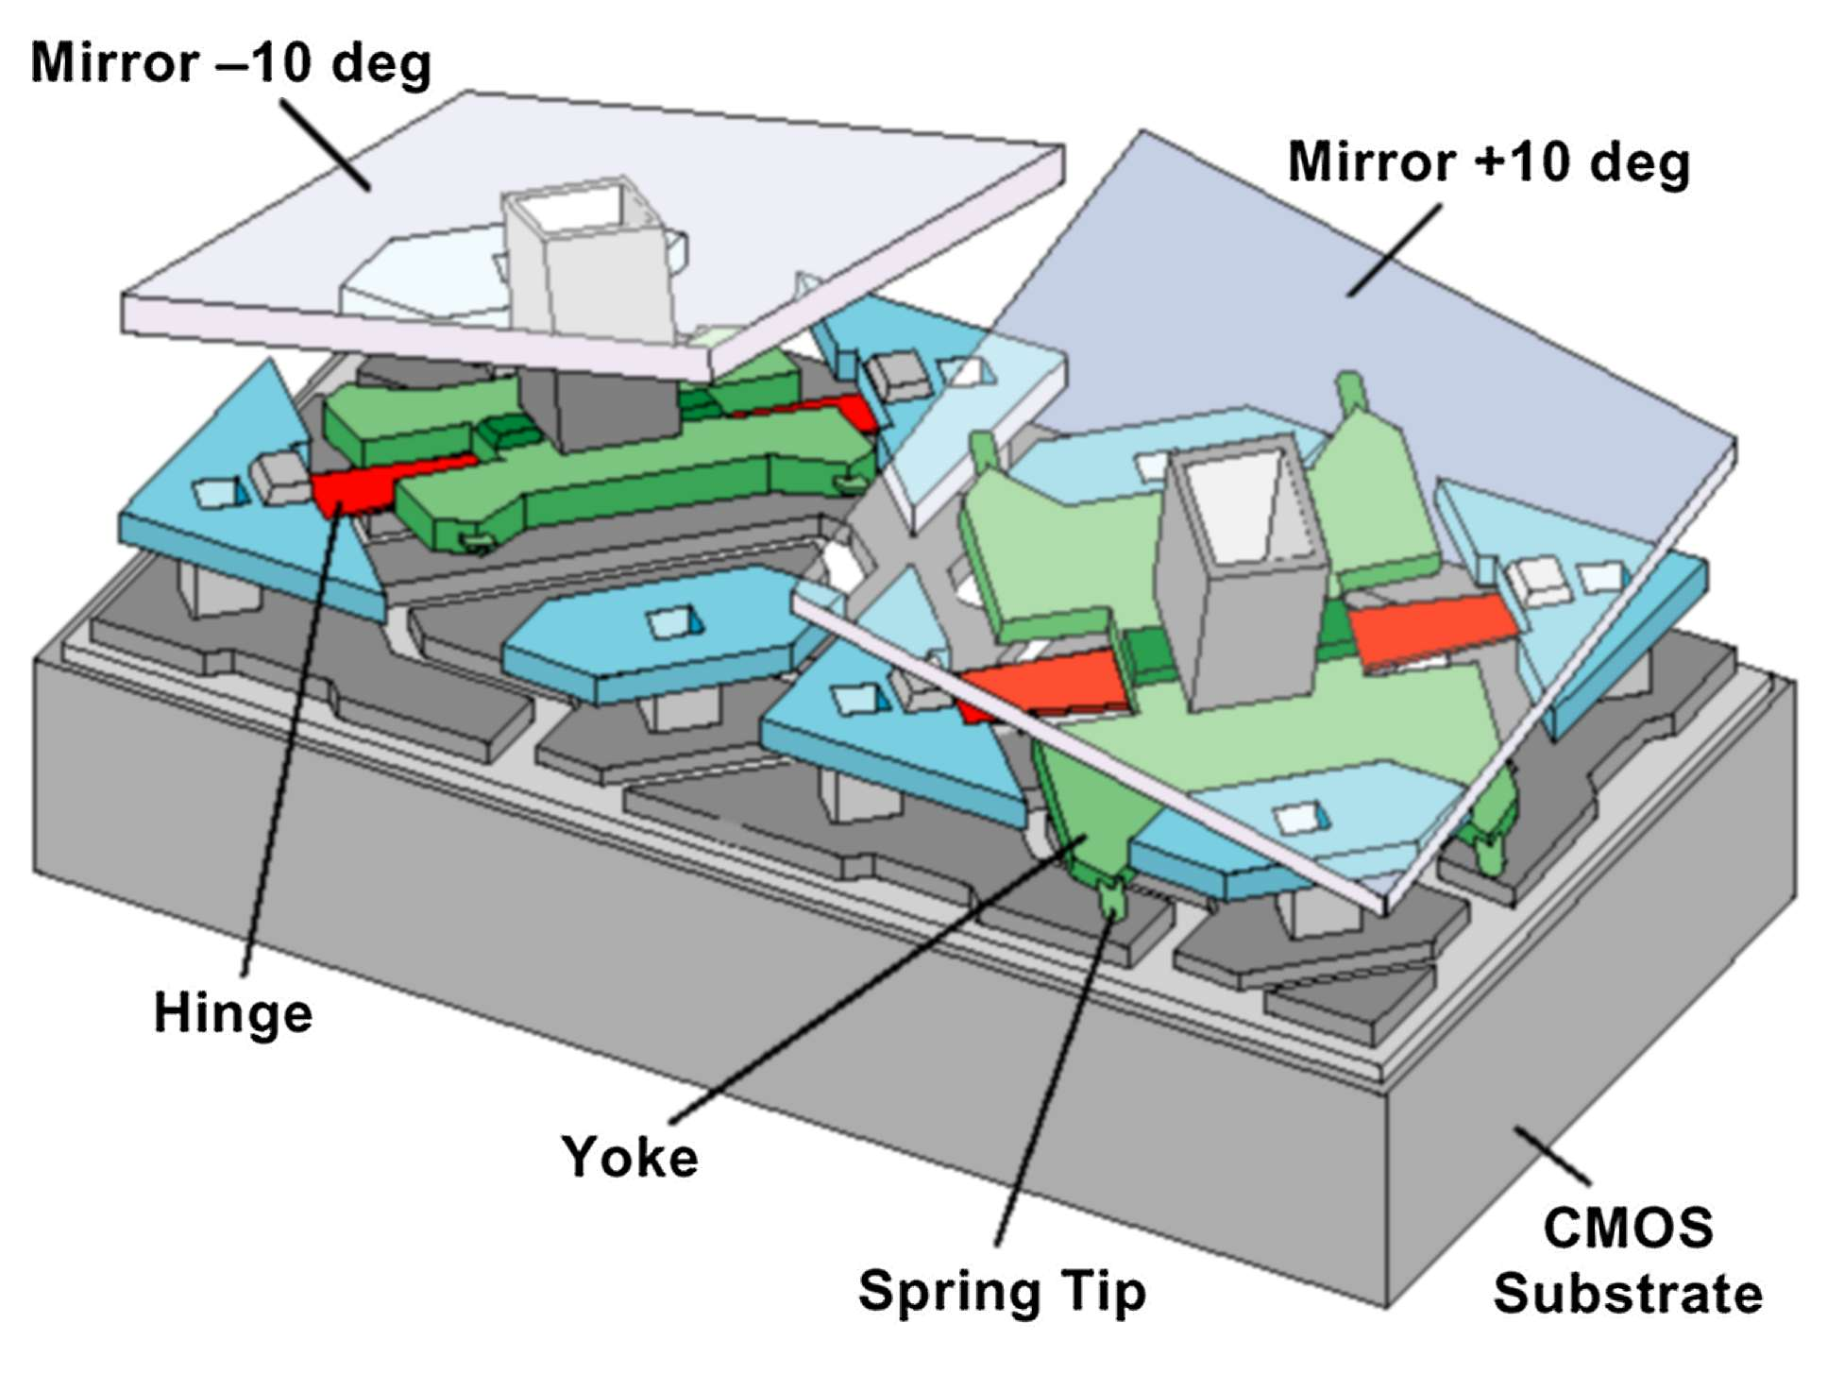
DMD

Slide 74
DMD
DMDs switch very quickly, much faster the LCDs
They are also very efficient, since there is very little light loss in the reflection, can be used for very bright projectors
The main use of DMDs is in projectors
At the low end a single DMD can produce colour by sequentially displaying red, green and blue images
Even low end DMDs operate at over 200Hz, so this works okay

Slide 75
DMD
High end projectors use three DMDs and then optical elements to combine the three images
This is the technology that is now used in movie theatres
They are sometimes called DLP projectors, it’s the same technology
Texas Instruments developed DMD and until recently this was patented, which kept the cost high

Slide 76
Summary
Surveyed the main hardware components that impact graphics
Examined GPU architectures and display technologies
If there is time later in the course we will examine how these technologies are used to build interesting devices
Need to know more about rendering before we can look at them

